Slide 1
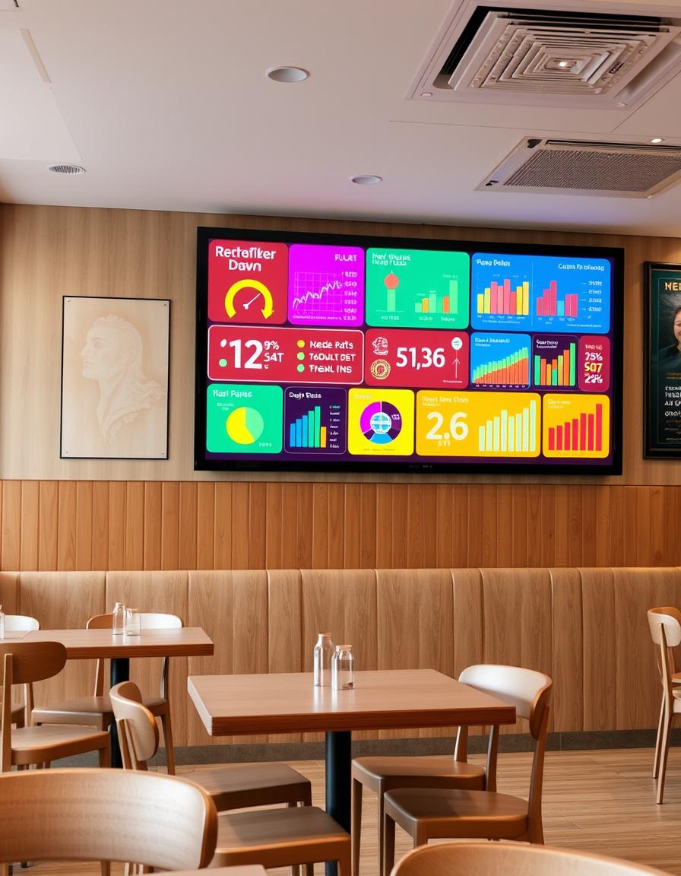
Presented By
Israa Mohamed Gaber
Moaz Ahmed
Amr Jamal

Slide 2
Introduction
For our project, we chose restaurant data because it's a rich source of insights that can directly impact sales and customer experience.
By analyzing trends in transactions, item sales, and customer preferences, we can identify areas for improvement and develop strategies to boost revenue.
Our process involved cleaning the data followed by detailed analysis. This helped us suggest actionable steps to optimize sales and enhance the overall performance of the restaurant.

Slide 3

Introduction and Objectives
This project aims to leverage data to improve restaurant operations and customer experience.
1
How To Clean Data
To clean data in Python, we can use libraries like Pandas to handle tasks such as removing duplicates, filling or dropping missing values, and correcting inconsistent formatting.
2
Understanding Customer Preferences
3
Optimizing Operations
Identify inefficiencies in staffing, inventory management, and kitchen processes to improve service and reduce costs.
Analyze customer feedback, orders, and spending patterns to understand what customers like and dislike.

Slide 4
Exploratory Data Analysis
Initial analysis helps to understand the data structure and identify potential patterns and relationships.
Descriptive Statistics
Data Visualization
Data Cleaning and Transformation
Calculate key metrics like average order value, customer churn rate, and inventory turnover.
Create charts and graphs to visualize trends, relationships, and outliers in the data.
Address missing values, inconsistent data entries, and other data quality issues.

Slide 5
How To clean Data
Fill Missing Values
Remove Rows or Columns With Missing Values
Naming Conventions
Remove Duplicates
Numeric Outliers
Remove Spaces In Character

Slide 6
NOW Let’s see cleaning stage in code

Slide 7
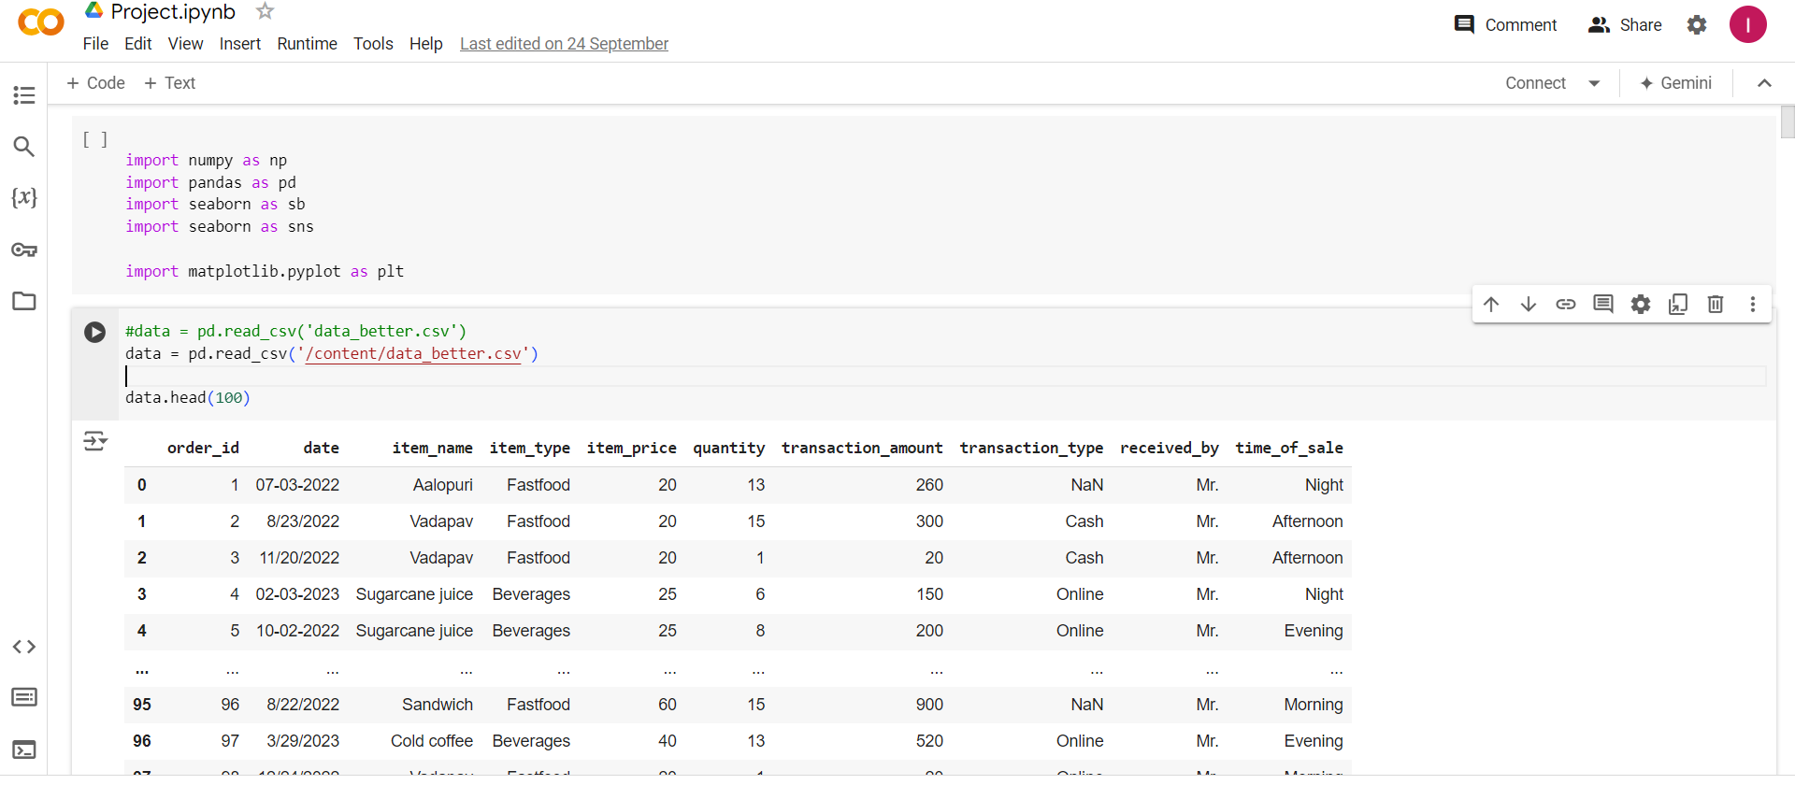
First we Need to read Data

Slide 8
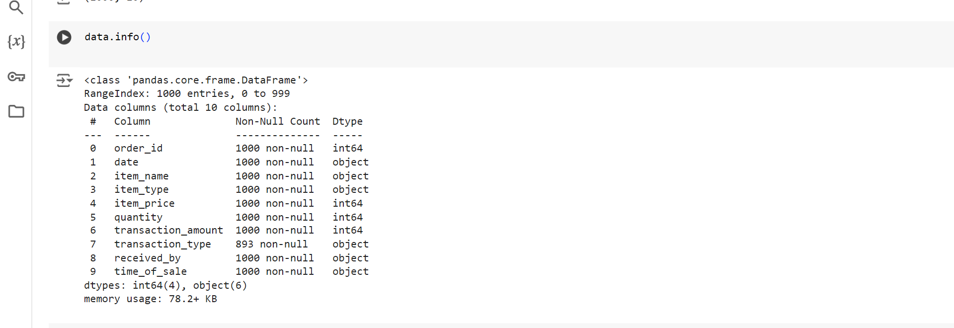
First step identify datatype of columns

Slide 9
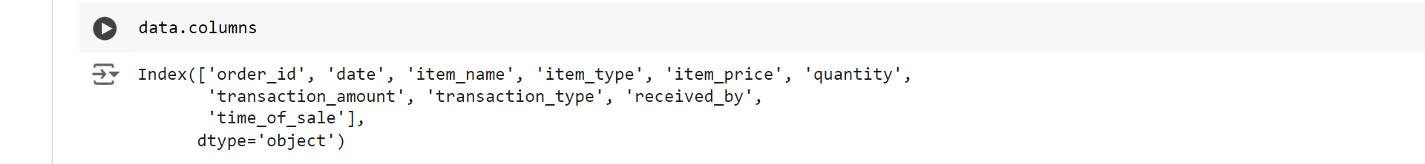
Second step Check columns name

Slide 10
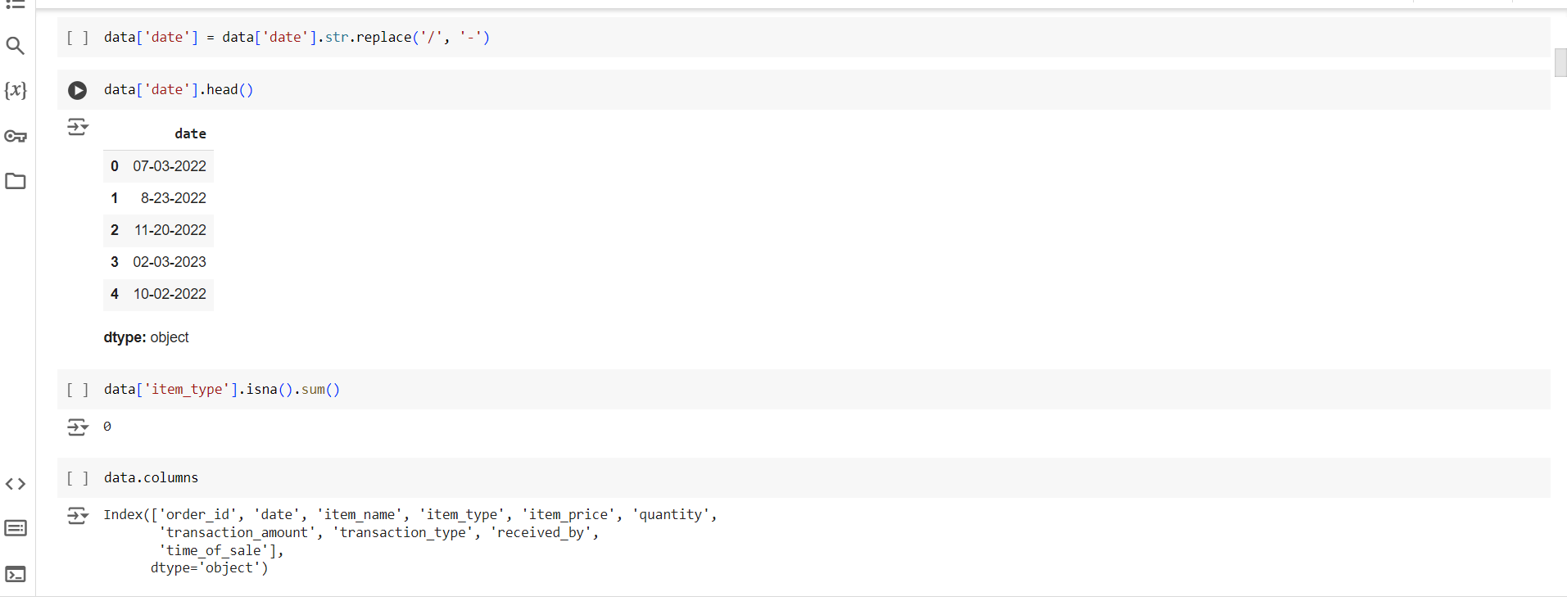
Change “/” by “–” to sort date in correct way

Slide 11
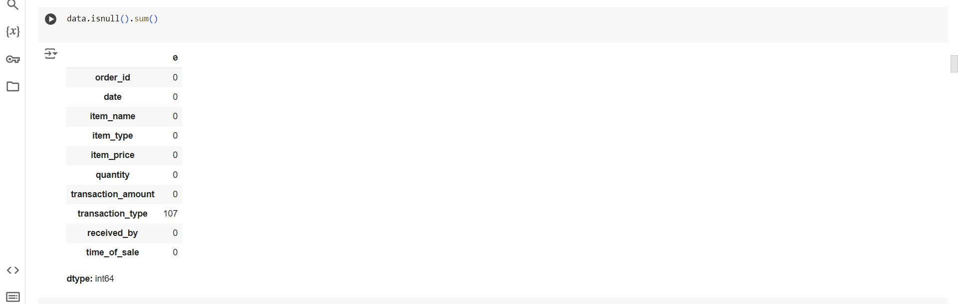
Check Nulls in Columns

Slide 12
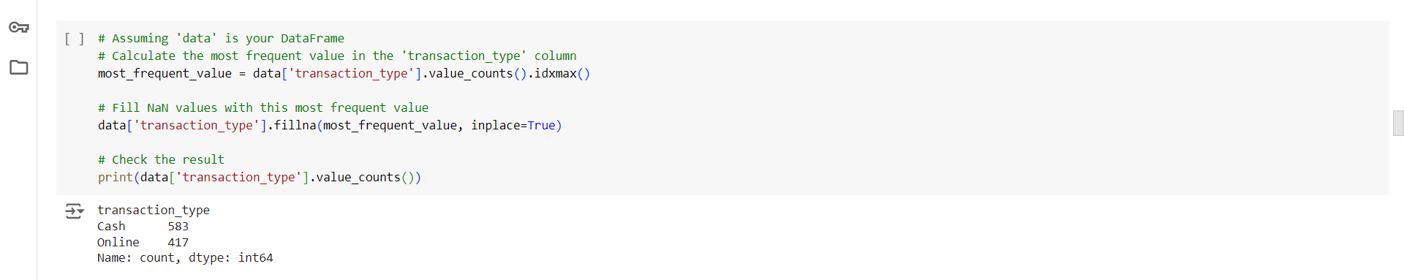
Fill Missing Value

Slide 13
NOW we Need To Calculate new column
To Calculate Total cost

Slide 14
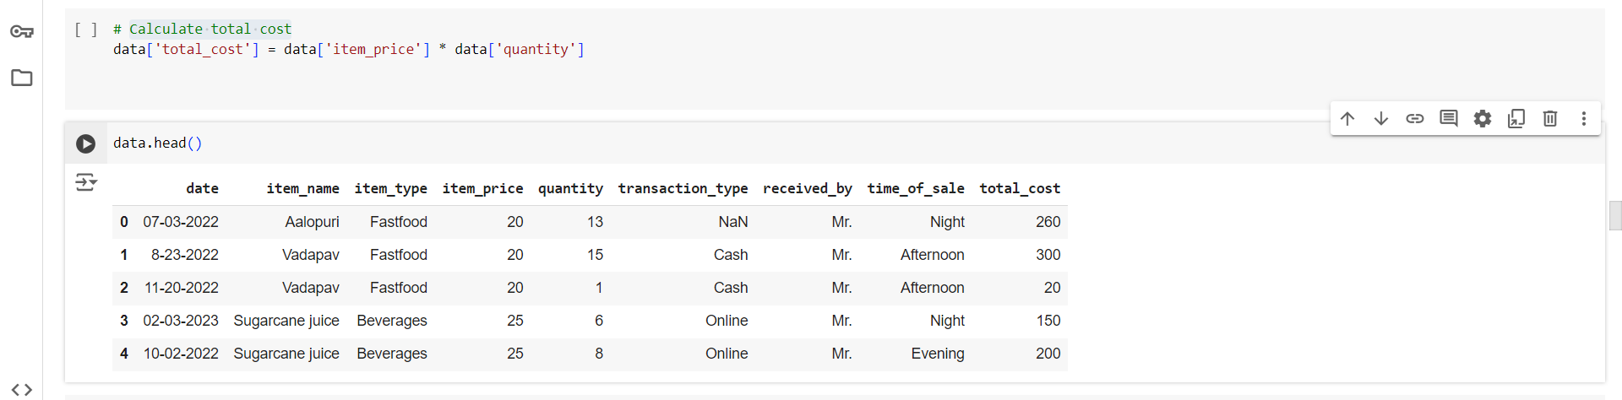
New Column

Slide 15
Check value count

Slide 16
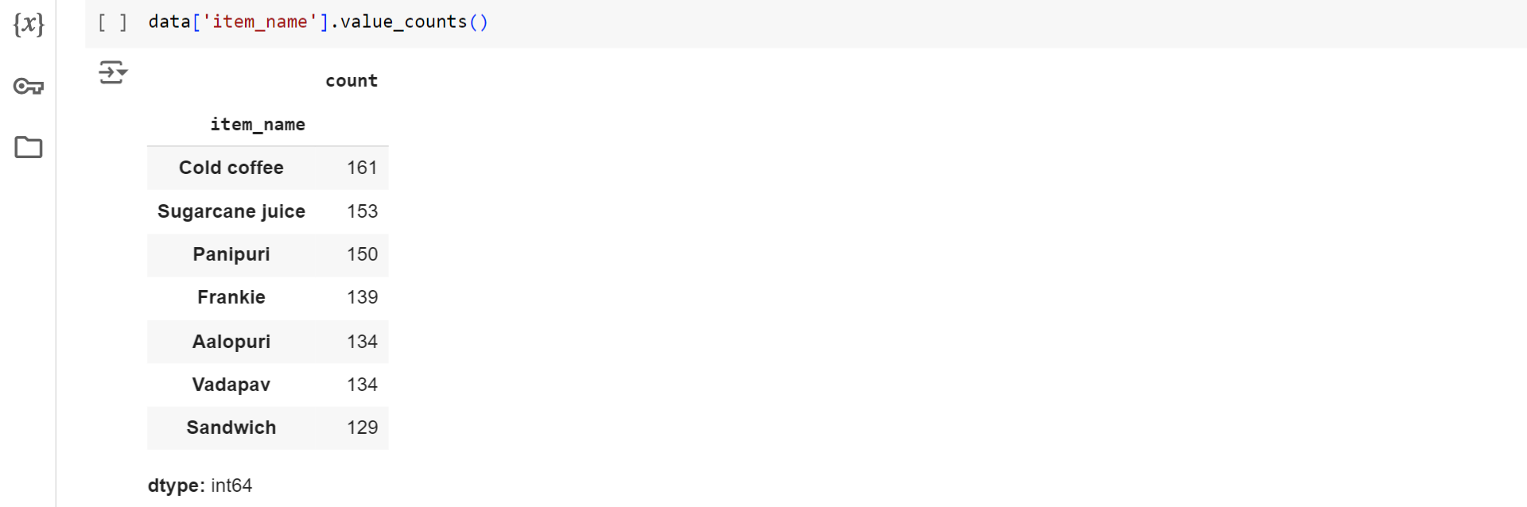
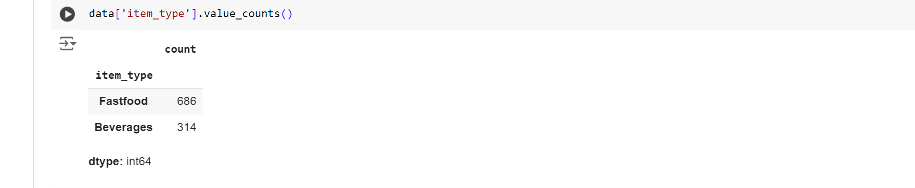
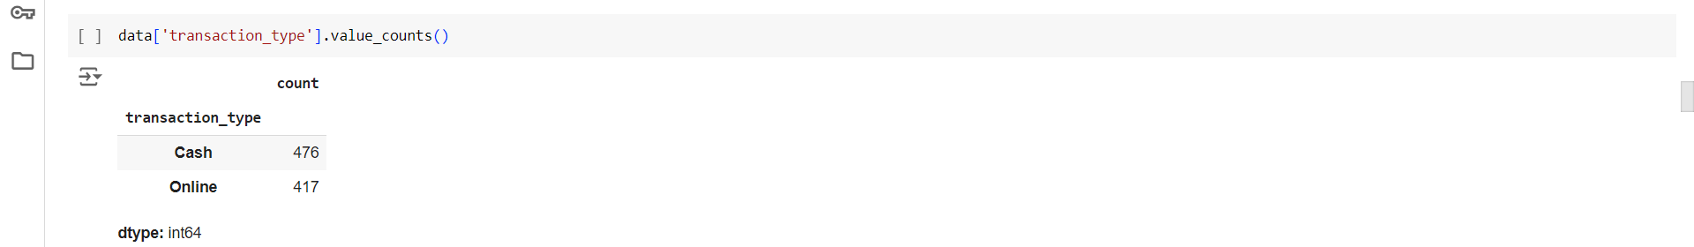
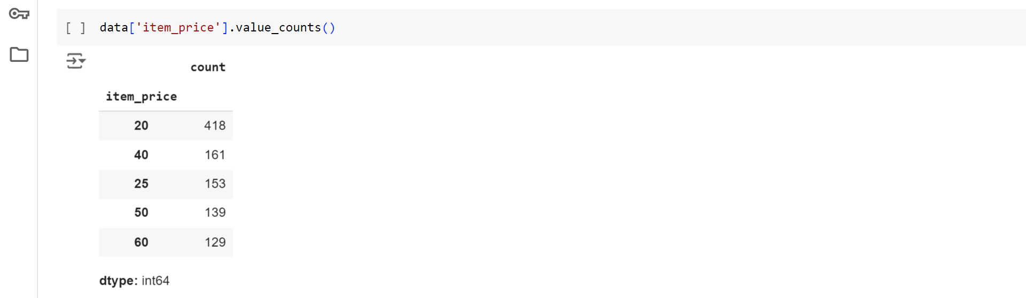
Code

Slide 17
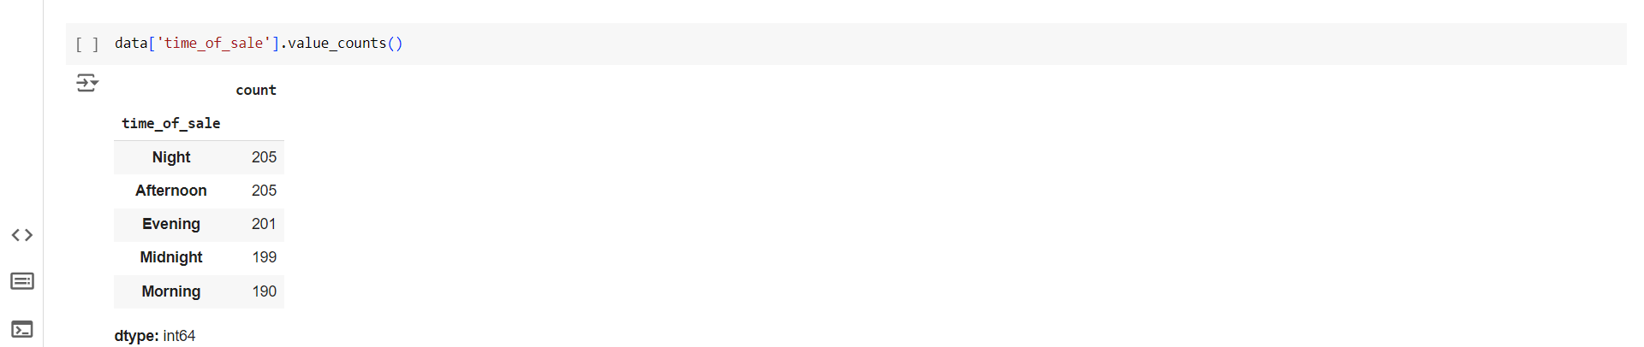
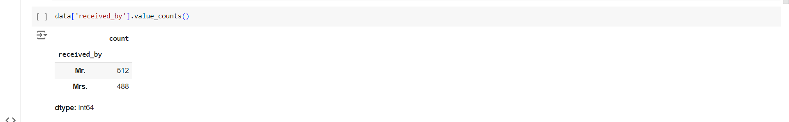
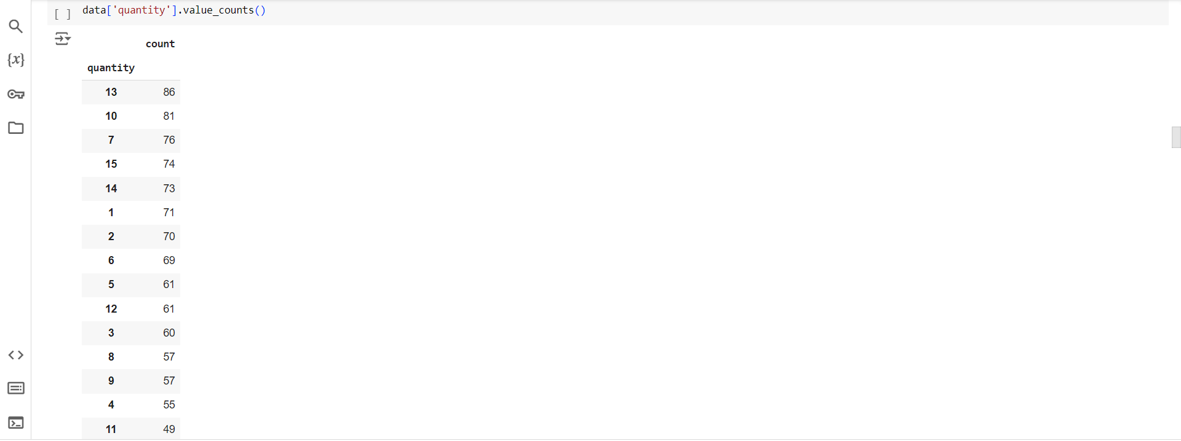
Code

Slide 18

We Need to understand customer Preference!

Slide 19
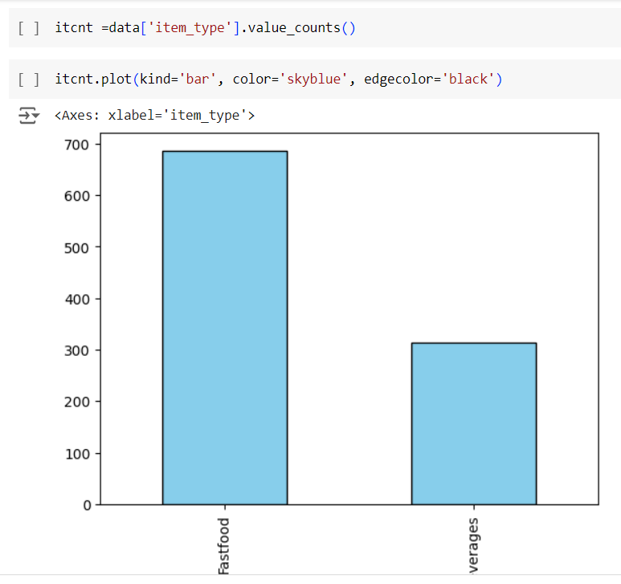
What is the Distribution of Item Types?

Slide 20
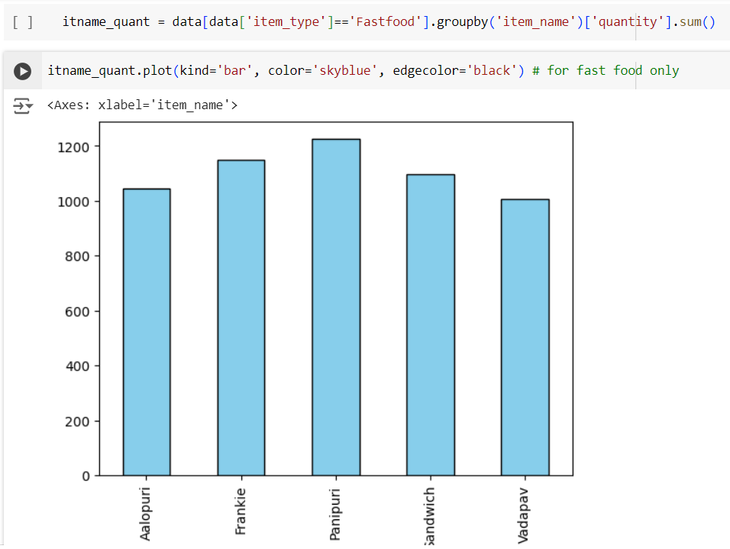
Which Fast Food Items Have the Highest Quantity sold ?

Slide 21
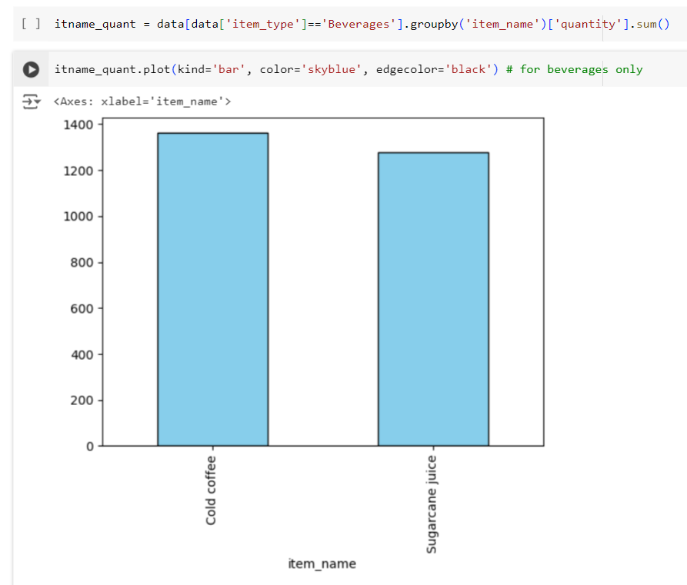
Which Beverage Items Have the Highest Quantity Sold?

Slide 22
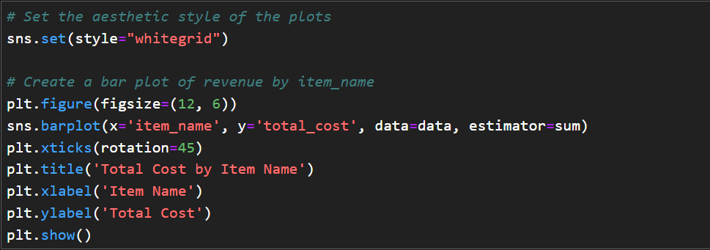
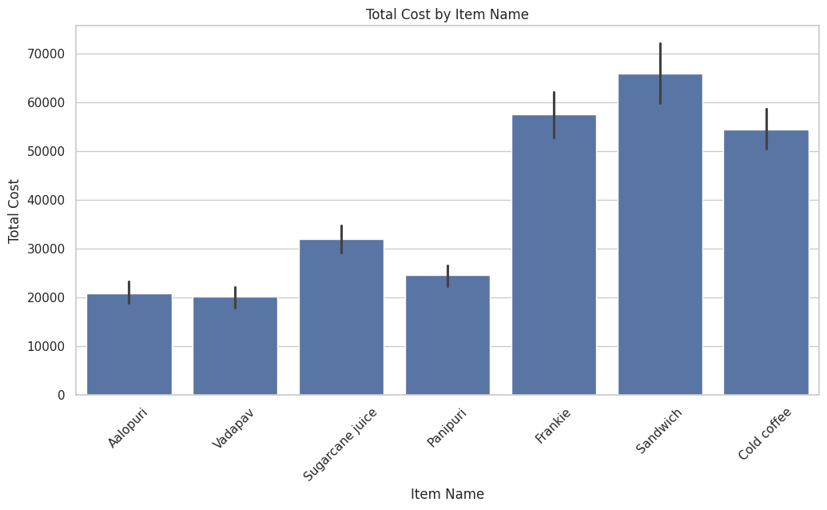
What is Most selling item ?

Slide 23
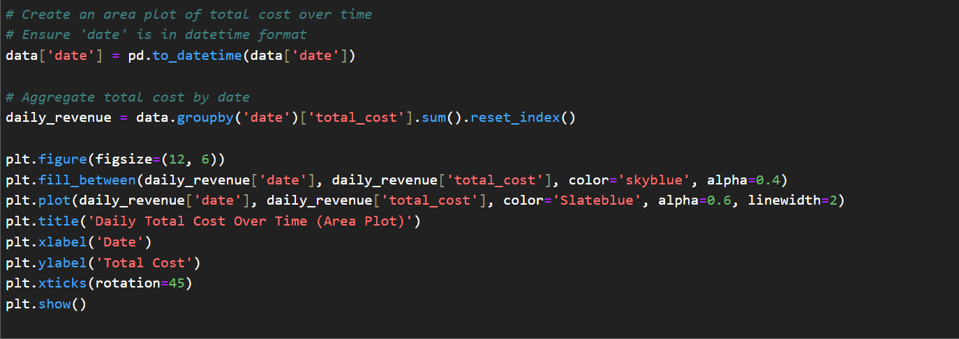
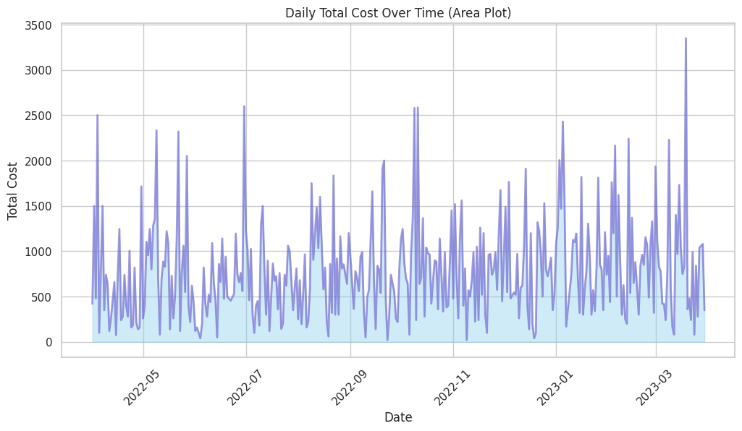
When were the highest total costs recorded?

Slide 24
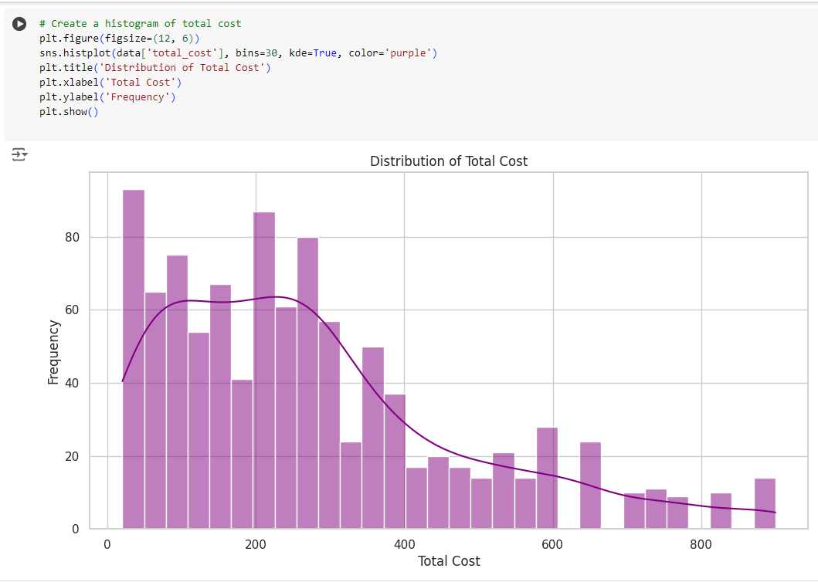
Distribution of Total Cost?

Slide 25
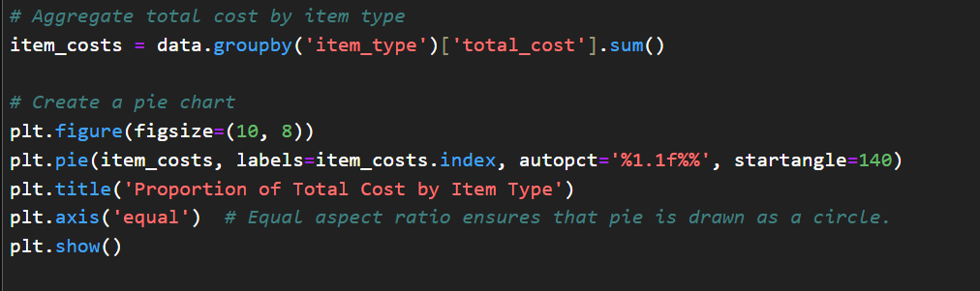
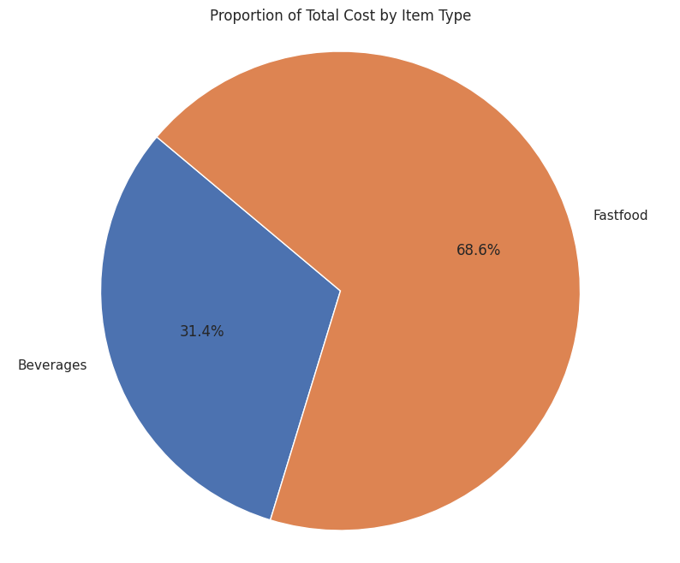
What is the Distribution of item type ?

Slide 26
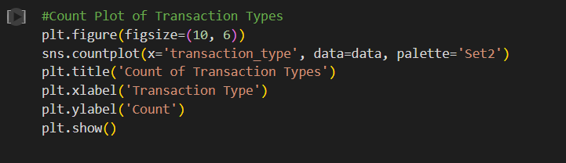
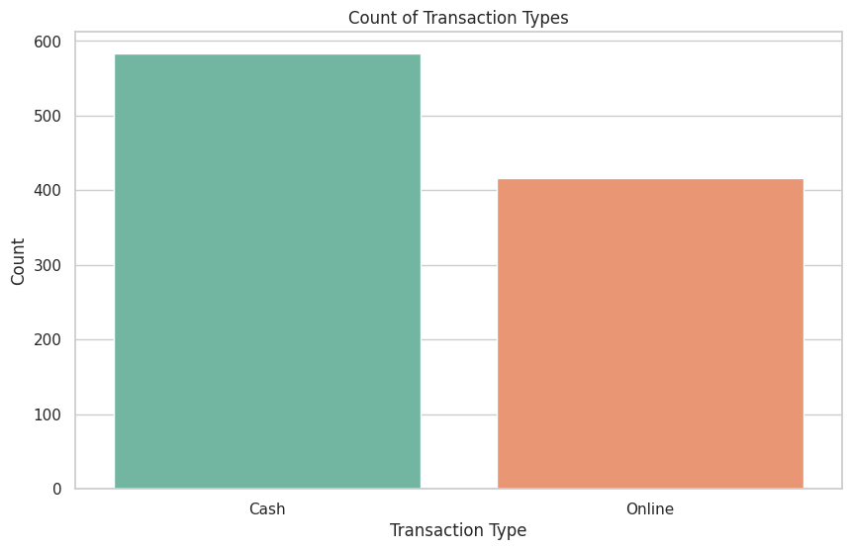
Which transaction type is used more frequently?

Slide 27
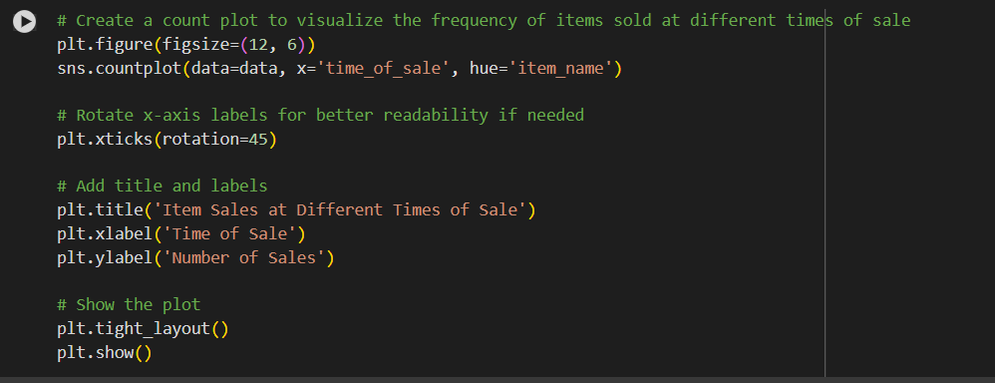
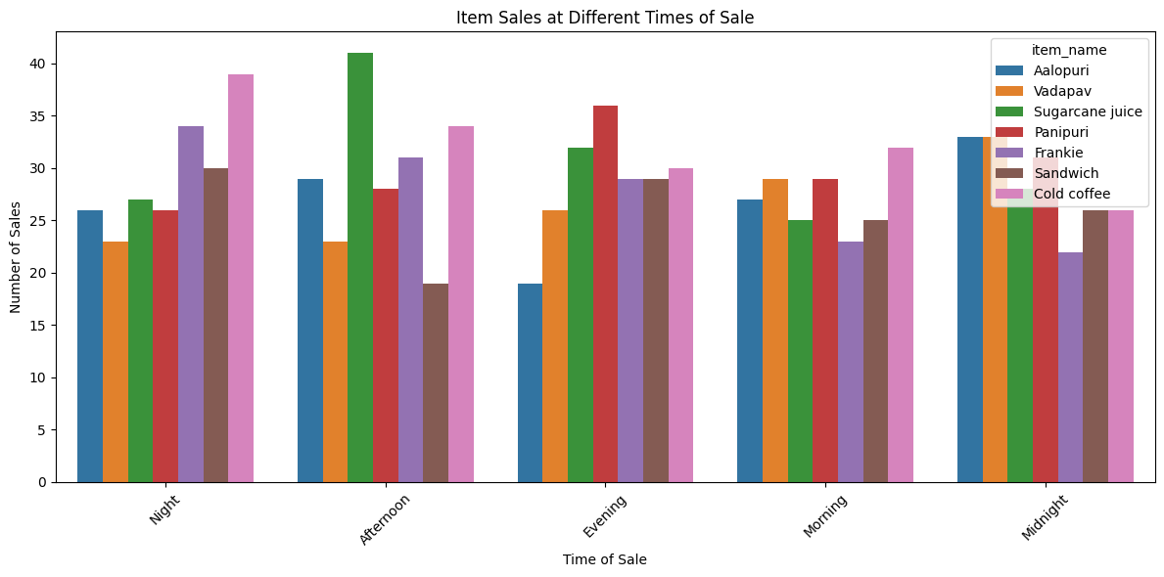
At what time of day are items sold the most frequently?

Slide 28
Conclusion

Slide 29





How to optimize operation
Data analysis can identify operational inefficiencies and suggest improvements.
Wait Times
Ingredient Usage
Analyze wait times to optimize staffing and improve customer service.
Track ingredient usage to reduce waste and optimize inventory management.
Labor Costs
Turnover Rate
Analyze labor costs to optimize staffing schedules and improve productivity.
Track employee turnover rate to identify potential issues and improve employee retention.

Slide 30

Recommendations and Action Plan
Data insights are translated into actionable recommendations to improve restaurant operations and customer experience.
Improve Menu Offerings
Increase Quantity of product
Based on customer preferences and sales trends, refine menu offerings and introduce new items.
Increase most sell product according to analysis
Optimize Marketing Campaigns
Increase Operational Efficiency
Develop targeted marketing campaigns based on customer segmentation and preferences.
Streamline kitchen processes, optimize inventory management, and implement cost-saving measures.

Slide 31
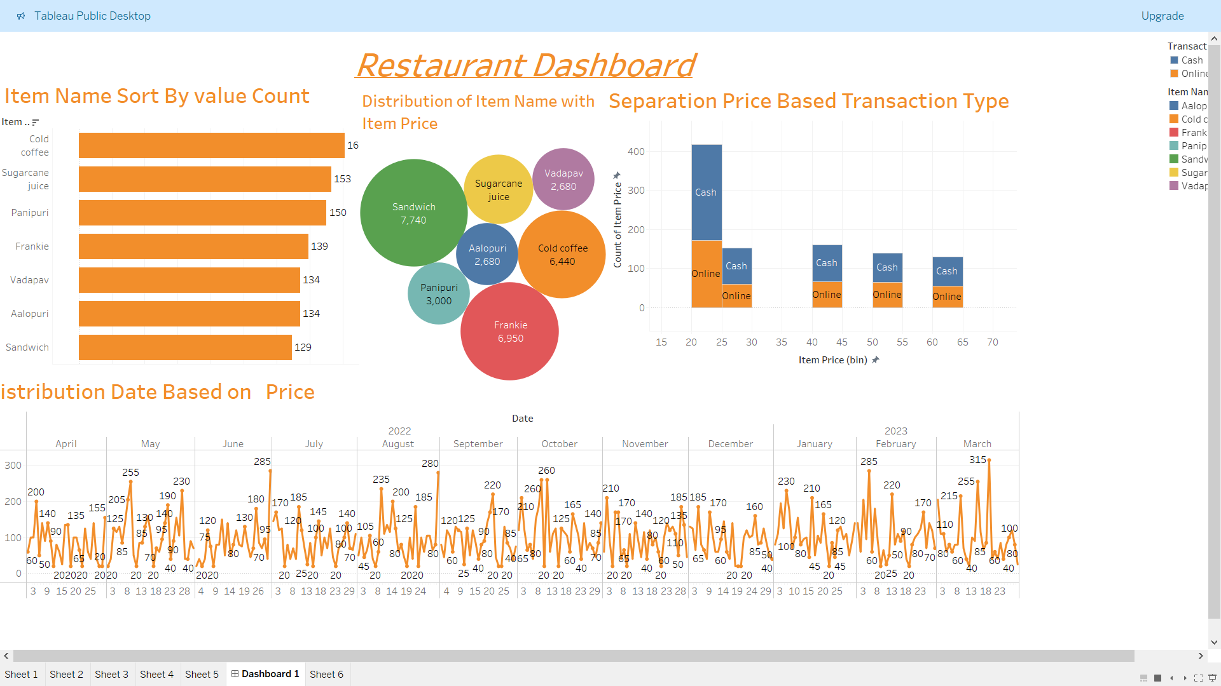

Slide 32
Thanks !

